Slide 1
Romania – Republic of Serbia IPA Cross-border Cooperation Programme
Programming Languages
Lecturer: lect. dr. eng. Razvan BOGDAN
Notes:
Slide 1: Hello everyone and welcome to programming languages course.

Slide 2
Programming Languages
Lecture 2
Variables, expressions and statements
Notes:
Slide 2: In this lecture we are going to talk about Variables, expressions and statements.

Slide 3
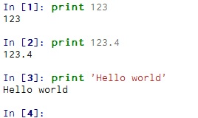
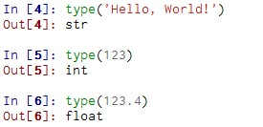
Constants
Fixed values such as numbers, letters, and strings are called “constants” - because their value does not change
Numeric constants
String constants use single-quotes (') or double-quotes (")
Notes:
Slide 3: Constants: We will start our presentation talking about constants. Constants are non-varying values. They can be numbers, like 123 which is an integer type or even strings, like Hello world. String constants use single-quotes (') or double-quotes ("). Another category of constants are numbers with a decimal point. They belong to a type called float,
because these numbers are represented in a format called floating-point. If you are not sure what type a value has, the python interpreter can tell you. In our example let’s type for example, type('Hello, World!') and will show that strings belong to the type str. If we want to decide for example 123 to what type belongs, we can write in Canopy type(123) and the result show us that integers belong to the type int. Other numbers like 123.4 are of float type.

Slide 4
Variables (1)
A variable is a named place in the memory where a programmer can store data and later retrieve the data using the variable “name”
Programmers get to choose the names of the variables
You can change the contents of a variable in a later statement
x = 10.3
y = 7
x = 10
10.3
x
10
y
7
Notes:
Slide 4: Variables (1): A variable is a named place in the memory where a programmer can store data and later retrieve the data using the variable “name”. An assignment statement creates new variables and gives them values. The content of a variable can be later changed by another assignment content. For example, the value associated with a variable is 10.3; later on, this value can be replaced by another assignment, let’s say x = 10; in this case, the value associated in the memory with variable x, will be 10. If we have y = 7, then in the memory there will be a place where value 7 will be stored, corresponding to variable y. That portion of memory where value 7 is stored will be called y.

Slide 5
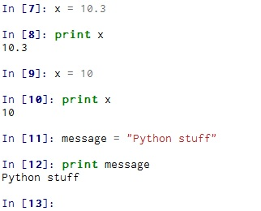
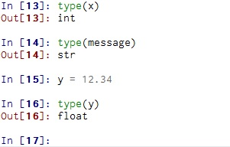
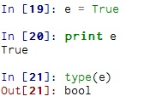
Variables (2)
To display the value of a variable, a print statement can be used
The type of a variable is the type of the value it refers to
Notes:
Slide 5: Variables (2): whenever we want to display the value of a variable, we can use a print statement; for example; also the type of a variable is the type of the value it refers to. The variable’s type can be obtained by using type. For example, we have a variable that contains a string, message = “Python stuff”. If we apply type to this message variable, the returned type is str. If the value associated with a variable is 12.34, then the returned type will be float; if the value associated with a variable, is for example, True, then the type will be bool. A bool type can have only two values: True or False.

Slide 6
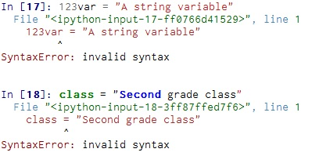
Python Variable Name Rules
We name variables to help us remember what we intend to store in them (“mnemonic” = “memory aid”)
Must start with a letter or underscore _
Must consist of letters and numbers and underscores
Case Sensitive
Good: firstName secondName11 _name
Bad: 11secondName #name var.23
Different: name Name NAME
Notes:
Slide 6: Python Variable Name Rules: Programmers generally choose names for their variables that are meaningful because they tend to document what the variable is used for. Variable names can contain both letters and numbers, but they have to begin with a letter. If you give a variable an illegal name, you get a syntax error. For example, 123var is illegal because it does not begin with a letter, while class turns out to be one of Python’s keywords. Such special words are used by Python interpreter in order to recognize the structure of the program.

Slide 7
Reserved Words
You can not use reserved words as variable names / identifiers
and del for is raise
assert elif from lambda return
break else global not try
class except if or while
continue exec import pass yield
def ﬁnally in print
Notes:
Slide 7: Reserved Words: Python reserves 31 keywords for its use. In Python 3.0, exec is no longer a keyword, but nonlocal is

Slide 8
Statements (1)
A statement is a unit of code that the Python interpreter can execute.
x = 1
x = x + 2
print x
Assignment Statement
Assignment with expression
Print statement
An assignment statement consists of an expression on the right hand side and a variable to store the result
x = 2.9 * x * ( 4 - x )
Notes:
Slide 8: Statements (1): A statement is a unit of code that the Python interpreter can execute. We have
seen two kinds of statements: print and assignment. We assign a value to a variable using the assignment statement (=). An assignment statement consists of an expression on the right hand side and a variable to store the result. After the right-hand operations have been computed, it takes that value and moves it in the variable. That x that appears in the right side refers to the previous, the old value of variable x. For example, if x had previously value 0.5, than,

Slide 9
Statements (2)
0.5
x
A variable is a memory location used to store a value (0.5).
0.5
0.5
x = 2.9 * x * ( 4 - x )
Right side is an expression. Once expression is evaluated, the result is placed in (assigned to) x.
3.5
5.075
Notes:
Slide 9: Statements (2): first of all we evaluate the parenthesis, and will result in 3.5. Then 2.9 will be multiplied by 0.5, then multiplied by 3.5 which is the result from parenthesis. In the end, the value of variable x will be 5.075.

Slide 10
Statements (3)
0.5
x
5.075
A variable is a memory location used to store a value (0.5).
x = 2.9 * x * ( 4 - x )
Right side is an expression. Once expression is evaluated, the result is placed in (assigned to) x.
5.075
Notes:
Slide 10: Statements (3): In this way, the old value of 0.5 will be deleted and replaced by the new value, which is 5.075

Slide 11
Numeric Expressions (1)
Because of the lack of mathematical symbols on computer keyboards - we use “computer-speak” to express the classic math operations
Asterisk is multiplication
Exponentiation (raise to a power) looks different from in math.
Operator | Operation
+ | Addition
- | Subtraction
* | Multiplication
/ | Division
** | Power
% | Remainder
Notes:
Slide 11: Numeric Expressions: Operators are special symbols that represent computations like addition and multiplication. The values the operator is applied to are called operands.
The operators +, -, *, / and ** perform addition, subtraction, multiplication, division and exponentiation

Slide 12
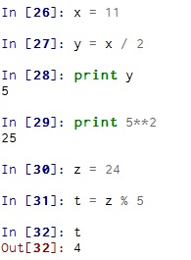

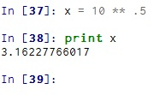
Numeric Expressions (2)
Operator | Operation
+ | Addition
- | Subtraction
* | Multiplication
/ | Division
** | Power
% | Remainder
Notes:
Slide 12: Numeric Expressions (2): So here are a few examples. Create the variable x and assign it to 11. Retrieve the old value and perform a division. The result put it in a new variable y and then print it with print. Following next we use the power operator directly in print. And now we're going to use the modular or modulo or remainder operator. Let’s take another variable that has value 24 and want to see what is the remainder when divide this variable z by 5. The result is 4. The cube is calculated like 4 power 3 and so on. The ** operator can also be utilized for root calculations since roots are just fraction exponents.

Slide 13
Order of Evaluation
When we string operators together - Python must know which one to do first
This is called “operator precedence”
Which operator “takes precedence” over the others
Parenthesis
Power
Multiplication
Addition
Left to Right
x = 1 + 2 ** 3 / 4 * 5
Notes:
Slide 13: Order of Evaluation: Now, just like in algebra and mathematics we have rules about which operations happen first. In general, things like the power happens before the multiplication and division, and then the addition and subtraction happen.
When more than one operator appears in an expression, the order of evaluation depends on the rules of precedence. For mathematical operators, Python follows mathematical convention.

Slide 14
Operator Precedence Rules (1)
Highest precedence rule to lowest precedence rule
Parenthesis are always respected
2 * (3 – 1) = 4
Exponentiation (raise to a power)
2**1+1 = 3
Multiplication, Division, and Remainder
2*3-1 = 5
Addition and Subtraction
Left to right
5-3-1 = 1
When writing code - use parenthesis
When writing code - keep mathematical expressions simple enough that they are easy to understand
Parenthesis
Power
Multiplication
Addition
Left to Right
Notes:
Slide 14: Operator Precedence Rules(1):
Parentheses have the highest precedence and can be used to force an expression to evaluate in the order you want. Since expressions in parentheses are evaluated first, 2 * (3-1) is 4
Exponentiation has the next highest precedence, so 2**1+1 is 3, not 4
Multiplication and Division have the same precedence, which is higher than Addition and Subtraction, which also have the same precedence. So 2*3-1 is 5, not 4
Operators with the same precedence are evaluated from left to right. So in the expression 5-3-1 is 1, not 3

Slide 15
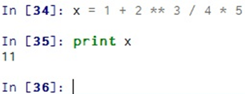
Operator Precedence Rules (2)
1 + 2 ** 3 / 4 * 5
1 + 8 / 4 * 5
1 + 2 * 5
Parenthesis
Power
Multiplication
Addition
Left to Right
1 + 10
11
Notes:
Slide 15: Operator Precedence Rules (2):
Let’s consider the following example. And so, we start with are there any parentheses ? And the answer is no, there are no parentheses. So let's go next. Power. So the 2 to the third power becomes 8, so it's 1 plus 8 over 4 times 5. Now we're going to do multiplication and division and we go across. Now we have both a division and multiplication. Okay? Multiplication and division are done at the same time, so that means we do left to right, which means we do the first one we encounter first. And so that will be 8 over 4 because of the left-to-right rule. And so we find that one, and that's the one that gets computed next, and that turns into 2. We're not done with multiplication yet. So the 2 over 5 is the next thing. And then we do that calculation, and that becomes 10, and again we rewrite it. And now we've done the multiplication, and next we're going to do addition. And that's just 1 over 10, and that becomes 11.

Slide 16
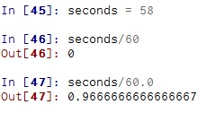
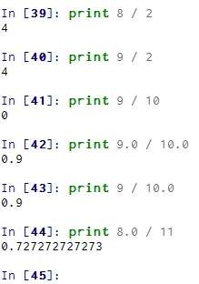
Integer division (1)
The division operator might not do what expected
Integer division truncates
Floating point division produces floating point numbers
When you perform an operation where one operand is an integer and the other operand is a floating point the result is a floating point
The integer is converted to a floating point before the operation
In Python 3 it changes: new operator // performs integer division
Notes:
Slide 16: Integer division(1): The division operator might not do what you expect: The value of seconds is 58, and in conventional arithmetic 58 divided by 60 is 0.9666, not 0. The reason for the discrepancy is that Python is performing floor division (however in Python 3.0, the result of this division is a float; In Python 3.0, the new operator // performs integer division.).
When both of the operands are integers, the result is also an integer; floor division chops off the fraction part, so in this example it rounds down to zero.
If either of the operands is a floating-point number, Python performs floating-point division, and the result is a float: let’s take for example seconds divided with 60.0 or 8.0 divided with 11. The result is a float.

Slide 17
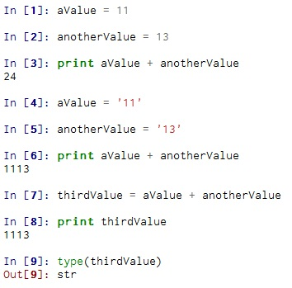

String operations(1)
Python knows the difference between an integer number and a string
For example “+” means “addition” if something is a number and “concatenate” if something is a string
* implies “multiple concatenation”
Notes:
Slide 17: String operations : The + operator works with strings, but it is not addition in the mathematical sense.
Instead it performs concatenation, which means joining the strings by linking them end-to-end. For example: there is a string variable aValue = single-quote ‘11’ and another string variable called anotherValue = ‘13’, so 2 strings. By using the + operator, we can concatenate these 2 string variables and obtain a new variable, let’s call it thirdValue who contains a string composed by the previous 2 strings, namely 1113.

Slide 18
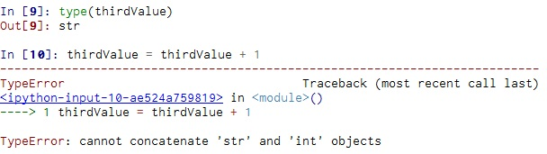
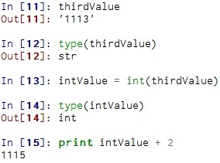
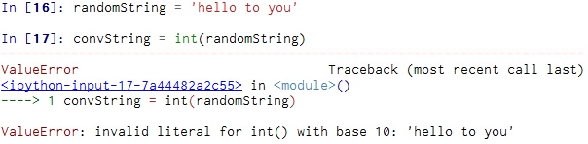
String operations(2)
Some operations are prohibited
You cannot “add 1” to a string
You can also use int() and float() to convert between strings and integers
You will get an error if the string does not contain numeric characters
Notes:
Slide 18: String operations(2) : Now, some operations are prohibited. If we want to add an integer 1 to a string, we will obtain a TypeError, because an integer cannot be added to a string. What can we do in this case? Well, we can convert the string to an integer value by using another variable, let’s call it intValue where we put the result of conversion obtained with int applied to variable thirdValue.
If we try to convert into integer a string variable that does not contain numeric characters, we will get a ValueError.

Slide 19
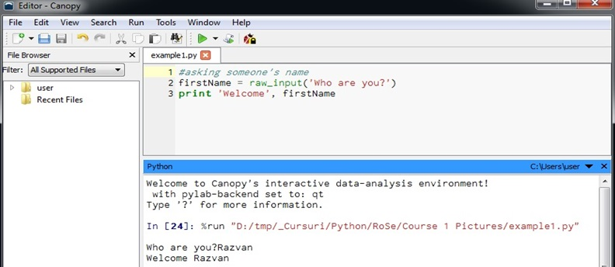
User Input(1)
We can instruct Python to pause and read data from the user using the raw_input function
The raw_input function returns a string
Comments: anything after a # is ignored by Python
For comments, also try '''
Notes:
Slide 19: User Input(1): Sometimes we would like to take the value for a variable from the user. In this case, the user should use their keyboard to introduce the value. Python provides a built-in function called raw_input that gets input from the keyboard.
When this function is called, the program stops and waits for the user to type something. When the user presses Return or Enter, the program resumes and raw_input returns what the user typed as a string. In this example, we created a small script who just asks for the name and greets that person.
The first line of the script is a comment. A comment is useful to Describe what is going to happen in a sequence of code or document who wrote the code or even to turn off a line of code - perhaps temporarily.

Slide 20
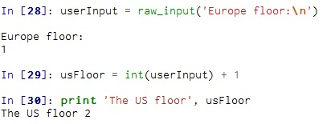
User Input(2)
If we want to read a number from the user, we must convert it from a string to a number using a type conversion function
The sequence \n at the end of the prompt represents a newline
Notes:
Slide 20: User Input(2): If we want to read a number from the user, we must convert it from a string to a number using a type conversion function. Let’s take an example that converts the European floor into the US representation. The sequence \n at the end of the prompt represents a newline, which is a special character that causes a line break. That’s why the user’s input appears below the prompt.

Slide 21
Homework
Write a program to prompt the user for hours and rate per hour to compute gross pay.
Enter hours: 40
Enter rate: 3.25
Pay: 130
Write a program which prompts the user for a Celsius temperature, convert the temperature to Fahrenheit and print out the converted temperature.
Notes:
Slide 21: Homework: As homework, please try and solve the following problems: first of all, calculate the gross pay taking into account the worked hours and the hourly rate and then convert a Celsius temperature into Fahrenheit. For both problems, print the obtained result. So, enjoy!

